Slide 1
Datatypes in Python Dr.Rakhee Chhibber

Slide 2

Agenda
Barebones of a python program
Datatypes in Python
Built-in datatypes
bool Datatype
Sequences in Python
Sets
User-defined Datatypes
Constants in Python
Naming Conventions in Python

Slide 3
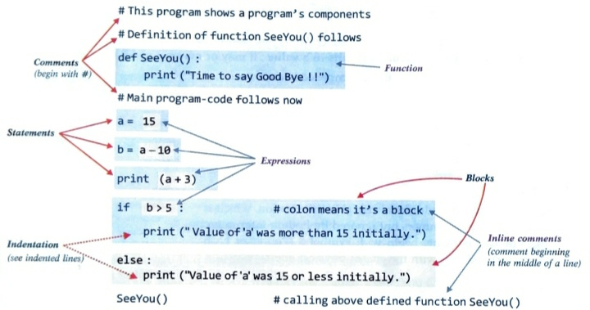
Barebones of a python program

Slide 4
Components of python program
Expressions
Statements
Comments
Function
Blocks and Indentation

Slide 5
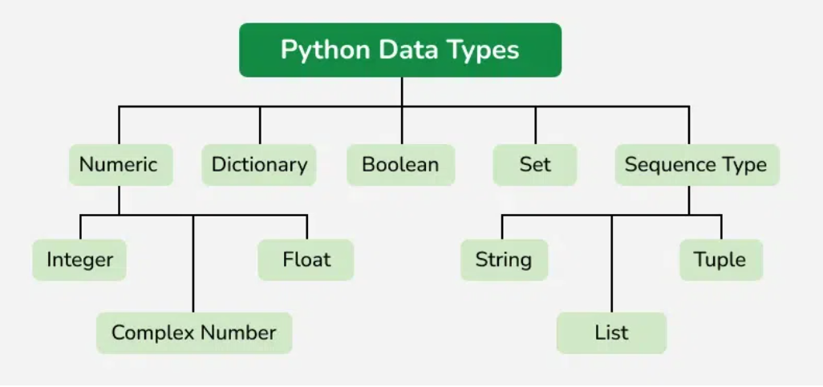

Slide 6
Numeric Data Type
int – unlimited range, subject to available virtual memory.
float - unlimited range, subject to available virtual memory.
complex – same as floating point numbers
booleans – 2 values True(1), False(0)

Slide 7
Sequence data types
String
List
Tuple

Slide 8
Strings in Python

Slide 9
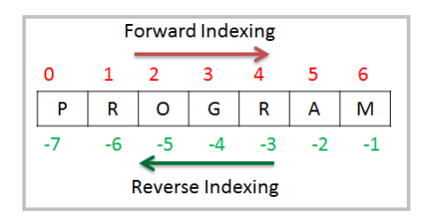
Indexing of Strings
Str = “PROGRAM”

Slide 10
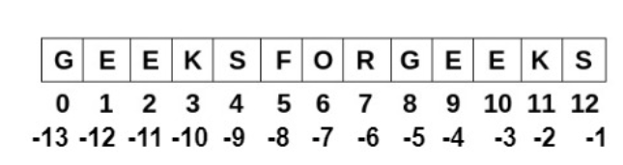
Accessing characters of String
s = "GeeksforGeeks"
print(s[0])
print(s[4])
print(s[-10])
print(s[-5])

Slide 11
Slicing in python
General syntax for slicing is
[start:end:step]
start: The index where the slice begins (inclusive). If omitted, it defaults to the beginning of the sequence (index 0).
end: The index where the slice ends (exclusive). If omitted, it defaults to the end of the sequence.
step: The increment between elements in the slice. If omitted, it defaults to 1. A negative step reverses the order of the slice.

Slide 12
Example
my_string = "Hello Python"
# Basic slicing
print(my_string[0:5]) # Output: Hello # Omitting start or end print(my_string[6:]) # Output: Python (from index 6 to end) # Slicing with a step print(my_string[:: -1]) # Output: nohtyP olleH (reverse string) # Negative indexing
print(my_string[-3:])

Slide 13
Practice
s = "GeeksforGeeks"
print(s[1:4])
print(s[:3])
print(s[3:])
print(s[::-1])

Slide 14
String Immutability
For Example
s = "geeksforGeeks"
# Trying to change the first character raises an error
s[0] = 'I’
# Instead, create a new string
s = "G" + s[1:]
print(s)

Slide 15
Deleting String
s = "GfG" # Deletes entire string
del s

Slide 16
Updating a String
s = "hello geeks"
# Updating by creating a new string
s1 = "H" + s[1:]
# replacnig "geeks" with "GeeksforGeeks"
s2 = s.replace("geeks", "GeeksforGeeks")
print(s1)
print(s2)

Slide 17
Common String Methods
len() | s = "GeeksforGeeks" print(len(s))
upper() and lower() | s = "Hello World" print(s.upper()) # output: HELLO WORLD print(s.lower()) # output: hello world
strip() and replace() | s = " Gfg " # Removes spaces from both ends print(s.strip()) s = "Python is fun" print(s.replace("fun", "awesome"))
join() | text = ['Anshul', 'is', 'my', 'only', 'friend'] # join elements of text with space print(' '.join(text))

Slide 18
Common String Methods
Capitalize() | sentence_1 = "mY name is YUVRAJ" sentence_2 = "MY name is Ansul" capitalized_string = sentence_1.capitalize() print("Sentence 1 output -> ", capitalized_string) capitalized_string = sentence_2.capitalize() print("Sentence 2 output -> ", capitalized_string)
Count | message = 'GFG KARLO HO JAYEGA' print('Number of occurrence of G:', message.count('G'))
Find | message = 'Yuvraj is my name' print(message.find('is'))
concatenation | s1 = "Hello" s2 = "World" s3 = s1 + " " + s2 print(s3)
Repetition | s = "Hello " print(s * 3)

Slide 19
Formatting Strings
Using f-strings | name = "Alice" age = 22 print(f"Name: {name}, Age: {age}")
Using format() | s = "My name is {} and I am {} years old.".format("Alice", 22) print(s)
Using in for String Membership Testing | s = "GeeksforGeeks" print("Geeks" in s) print("GfG" in s)

Slide 20
List in python

Slide 21
Lists
Lists are just like arrays, declared in other languages which is an ordered collection of data. It is very flexible as the items in a list do not need to be of the same type.
# Empty list
a = []
# list with int values
a = [1, 2, 3]
print(a)
# list with mixed int and string
b = ["Geeks", "For", "Geeks", 4, 5]
print(b)

Slide 22
Accessing the list items
a = ["Geeks", "For", "Geeks"]
print("Accessing element from the list")
print(a[0])
print(a[2])
print("Accessing element using negative indexing")
print(a[-1])
print(a[-3])

Slide 23
Tuple in python

Slide 24
tuple
Just like a list, a tuple is also an ordered collection of Python objects. The only difference between a tuple and a list is that tuples are immutable. Tuples cannot be modified after it is created.
# initiate empty tuple
tup1 = ()
tup2 = ('Geeks', 'For')
print("\nTuple with the use of String: ", tup2)
tup1 = tuple([1, 2, 3, 4, 5])

Slide 25
accessing tuple items
print(tup1[0])
print(tup1[-1])
print(tup1[-3])

Slide 26
Set Data Type in Python
Set is an unordered collection of data types that is iterable, mutable, and has no duplicate elements. It can be created using curly braces{} separated by a ‘comma’
# initializing empty set
s1 = set()
s1 = set("GeeksForGeeks")
print("Set with the use of String: ", s1)
s2 = set(["Geeks", "For", "Geeks"])
print("Set with the use of List: ", s2)

Slide 27
Dictionary data type

Slide 28
Dictionary
A dictionary in Python is a collection of data values, used to store data values like a map, unlike other Python Data Types that hold only a single value as an element, a Dictionary holds a key: value pair. Key-value is provided in the dictionary to make it more optimized. Each key-value pair in a Dictionary is separated by a colon : , whereas each key is separated by a ‘comma’.
# initialize empty dictionary
d = {}
d = {1: 'Geeks', 2: 'For', 3: 'Geeks'}
print(d)
# creating dictionary using dict() constructor
d1 = dict({1: 'Geeks', 2: 'For', 3: 'Geeks'})
print(d1)

Slide 29
Accessing Key-value in dictionary
d = {1: 'Geeks', 'name': 'For', 3: 'Geeks'}
# Accessing an element using key
print(d['name'])
# Accessing a element using get
print(d.get(3))

Slide 30
User-defined data types
Classes
Enumerations

Slide 31
Python Constant
1. Mathematical Constant:
PI = 3.14159
E = 2.71828
GRAVITY = 9.8
2. Configuration settings:
MAX_CONNECTIONS = 1000
TIMEOUT = 15
3. UI Color Constants:
BACKGROUND_COLOR = "#FFFFFF"
TEXT_COLOR = "#000000"
BUTTON_COLOR = "#FF5733"

Slide 32
Naming Conventions in Python
Python constant and variable names can include:
Lowercase letters (a-z)
Uppercase letters (A-Z)
Digits (0-9)
Underscores (_)
Naming rules for constants:
Use UPPERCASE letters for constant names (e.g., CONSTANT = 65).
Do not start a constant name with a digit.
Only the underscore (_) is allowed as a special character; other characters (e.g., !, #, ^, @, $) are not permitted.
Best practices for naming constants:
Use meaningful and descriptive names (e.g., VALUE instead of V) to make the code clearer and easier to understand.

Slide 33

Part 2

Slide 34
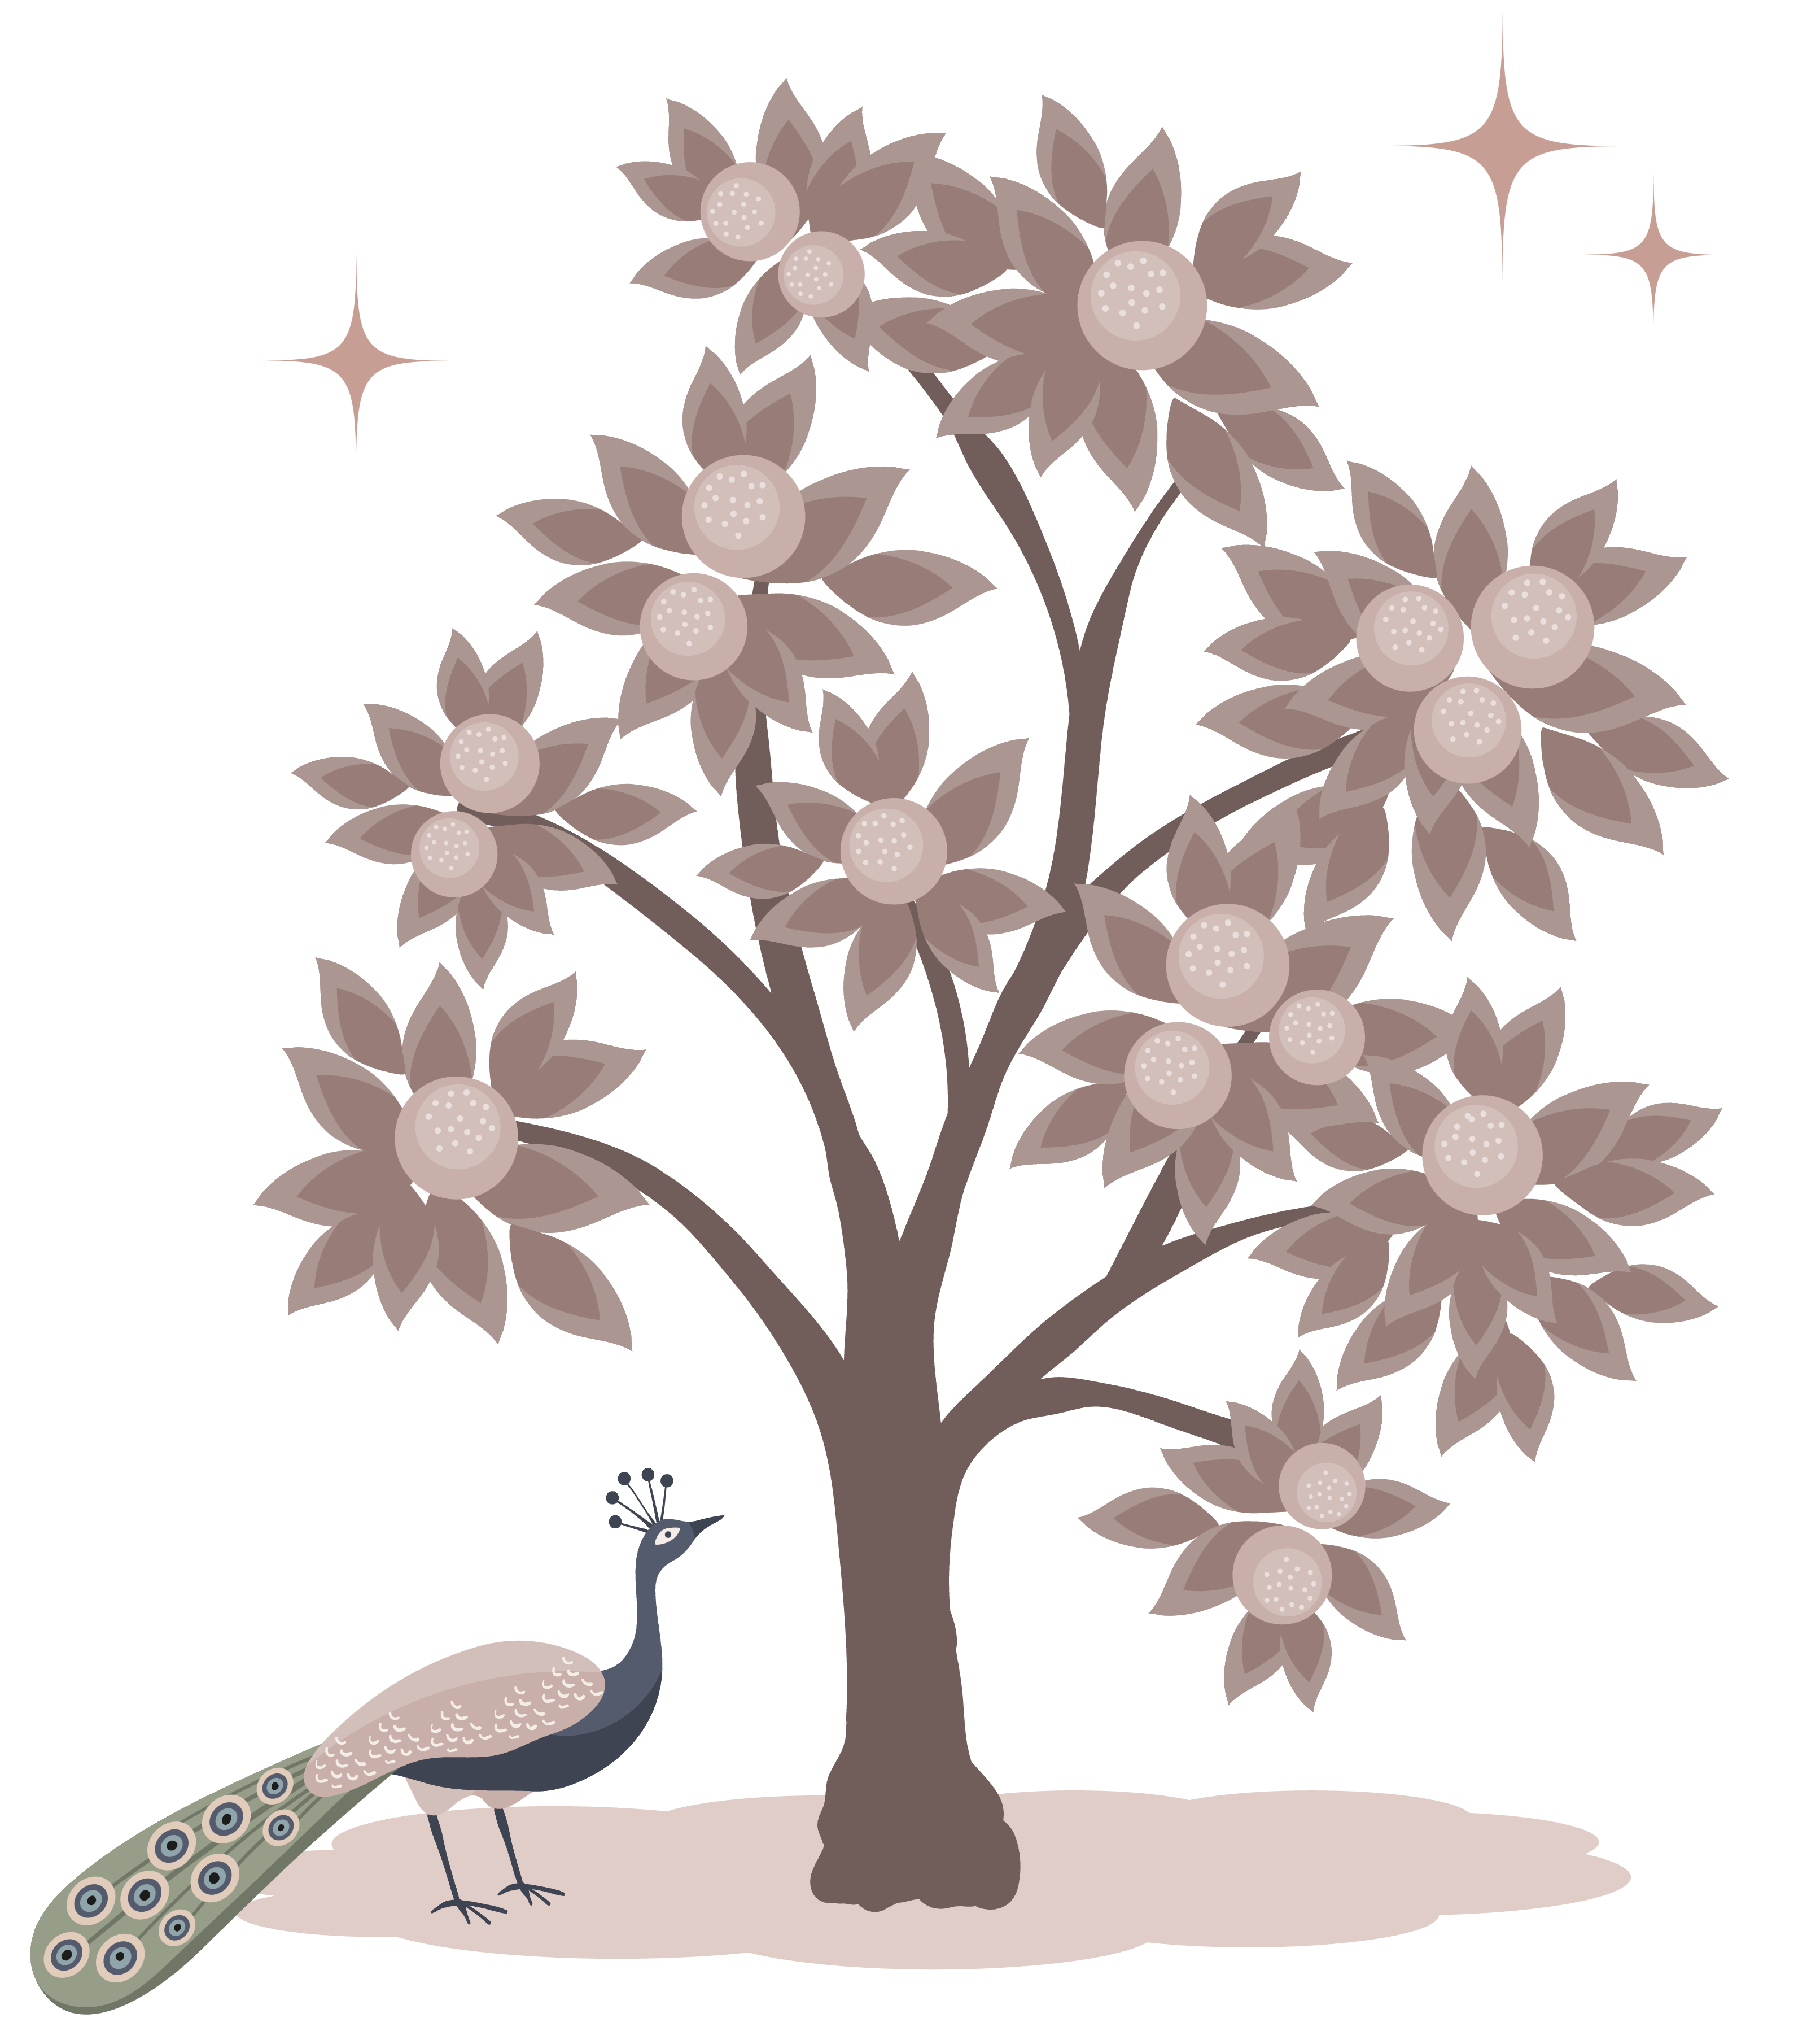
Agenda
Python Control Statements
IF...Else
While Loops
For Loops
Match-Case Statement
break statement
continue statement
nested if
nested loops

Slide 35
Control statements
If
Loops
Match-case
Break
Continue
Nested if
Nested loops

Slide 36
If statement
if condition: # Statements to execute if the condition is true | if (condition): # Executes this block if the condition is true else: # Executes this block if the condition is false
if (condition1): # Executes when condition1 is true if (condition2): # Executes when condition2 is true # if Block is end here # if Block is end here | if (condition1): # Statements to execute if condition1 is true if (condition2): # Statements to execute if condition2 is true else: # Statements to execute if condition2 is false else: # Statements to execute if condition1 is false
if (condition): statement elif (condition): statement . . else: statement | Ternary Conditional Statement in Python # Assign a value based on a condition age = 20 s = "Adult" if age >= 18 else "Minor" print(s)

Slide 37
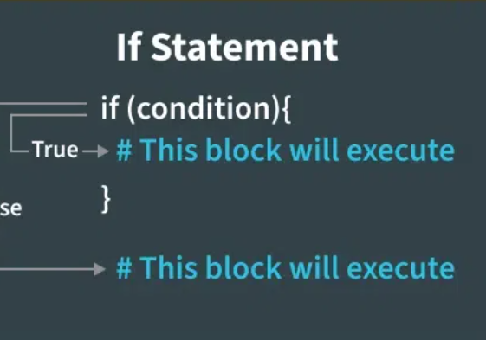
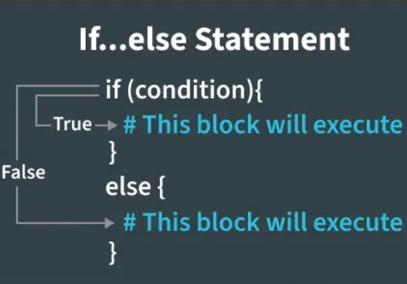

Slide 38
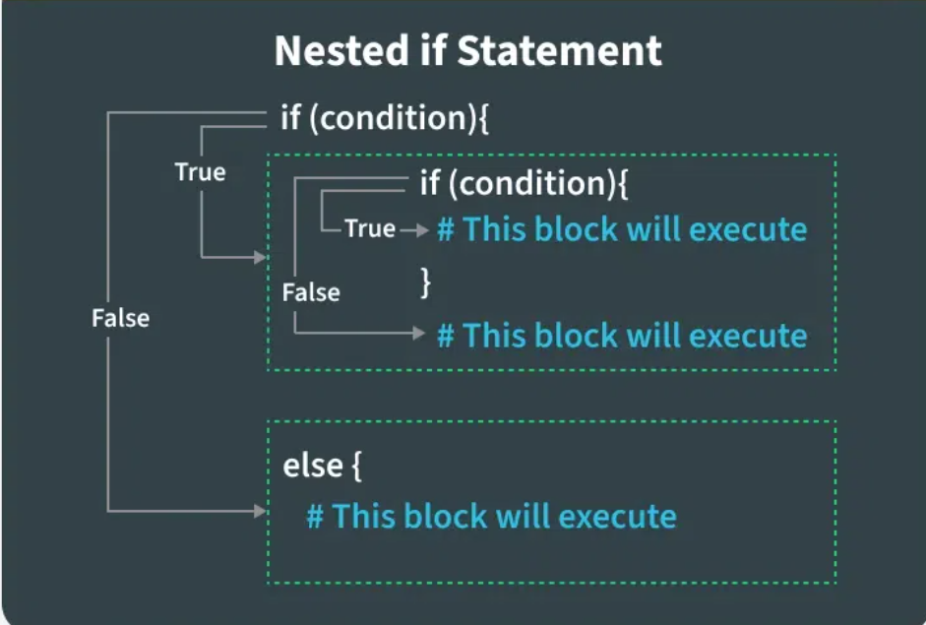

Slide 39
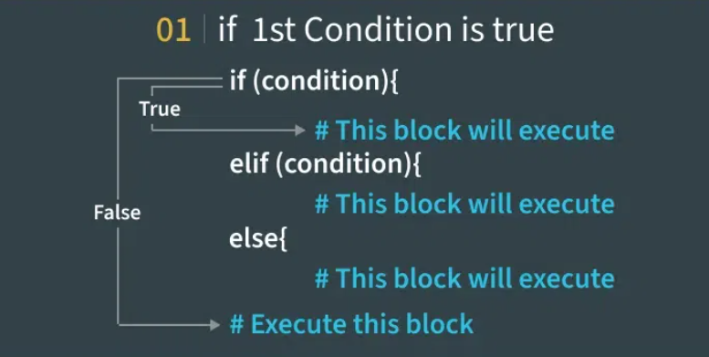

Slide 40
Match-case
number = 2
match number:
case 1:
print("One")
case 2 | 3:
print("Two or Three")
case _:
print("Other number")

Slide 41
Ternary operator
Example 1- if - else
n = 5
res = "Even" if n % 2 == 0 else "Odd"
Print(res)
Example 2 – nested if
n = -5
res = "Positive" if n > 0 else "Negative" if n < 0 else "Zero"
print(res)

Slide 42
Iteration/loops

Slide 43
Range function
The Python range() function returns a sequence of numbers, in a given range. The most common use of it is to iterate sequences on a sequence of numbers using Python loops.
for i in range(5):
print(i, end=" ")
print()

Slide 44
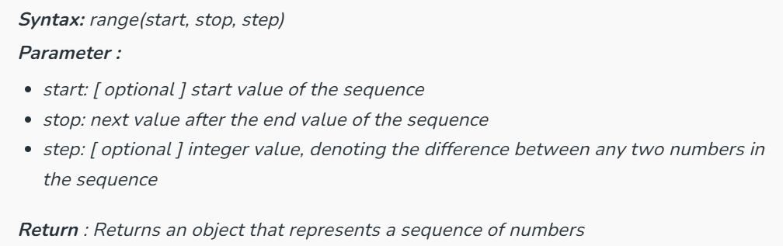
Syntax of Python range() function

Slide 45
range() function – 3ways
range (stop) takes one argument.
range (start, stop) takes two arguments.
range (start, stop, step) takes three arguments.

Slide 46
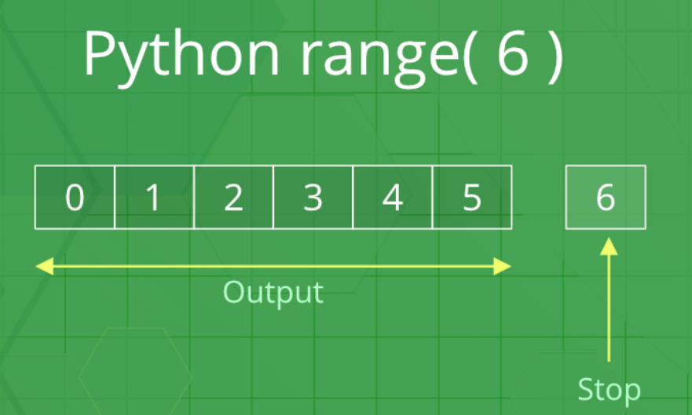
range (stop)
# printing first 6
# whole number
for i in range(6):
print(i, end=" ")
print()

Slide 47
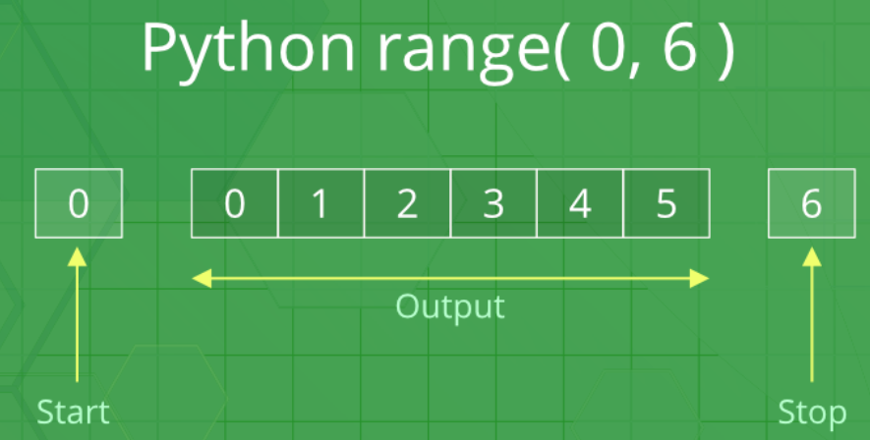
Python range (start, stop)
# printing a natural
# number from 5 to 20
for i in range(5, 20):
print(i, end=" ")

Slide 48
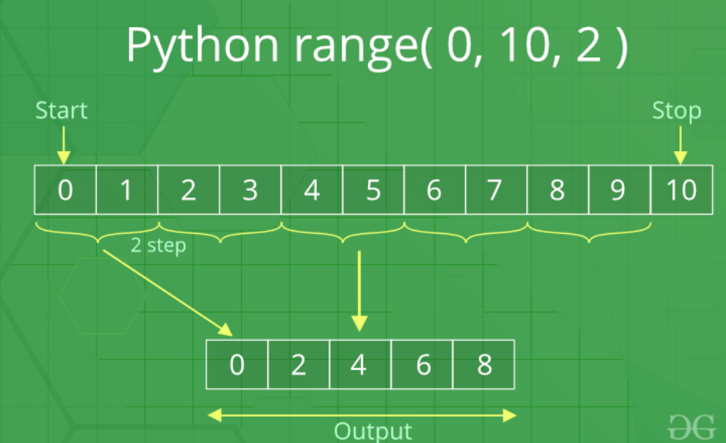
Python range (start, stop, step)
for i in range(0, 10, 2):
print(i, end=" ")
print()

Slide 49
Python range() using Negative Step
# incremented by -2
for i in range(25, 2, -2):
print(i, end=" ")
print()

Slide 50
range() function with List in Python
fruits = ["apple", "banana", "cherry", "date"]
for i in range(len(fruits)):
print(fruits[i])

Slide 51
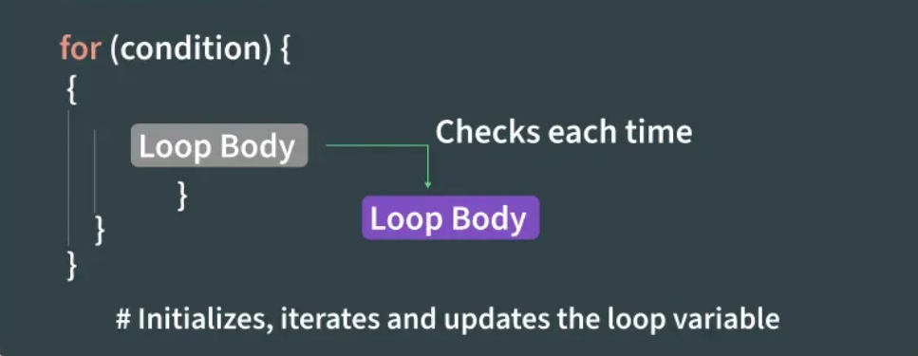
Loops – for loop
for iterator_var in sequence: statements(s)
n = 4
for i in range(0, n):
print(i)

Slide 52
Iterating Over List, Tuple, String and Dictionary Using for Loops in Python
li = ["geeks", "for", "geeks"]
for i in li:
print(i)
tup = ("geeks", "for", "geeks")
for i in tup:
print(i)
s = "Geeks"
for i in s:
print(i)
d = dict({'x':123, 'y':354})
for i in d:
print("%s %d" % (i, d[i]))
set1 = {1, 2, 3, 4, 5, 6}
for i in set1:
print(i),

Slide 53
Iterating by the Index of Sequences
li = ["geeks", "for", "geeks"]
for index in range(len(li)):
print(li[index])

Slide 54
Using else Statement with for Loop in Python
li = ["geeks", "for", "geeks"]
for index in range(len(li)):
print(li[index])
else:
print("Inside Else Block")

Slide 55
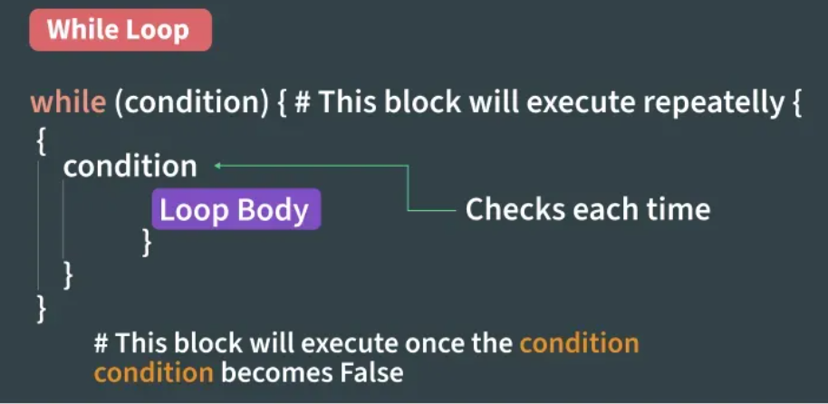
While Loop in Python
cnt = 0
while (cnt < 3):
cnt = cnt + 1
print("Hello Geek")

Slide 56
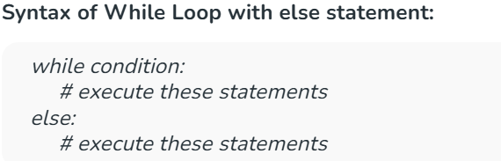
Using else statement with While Loop in Python
cnt = 0
while (cnt < 3):
cnt = cnt + 1
print("Hello Geek")
else:
print("In Else Block")

Slide 57
Infinite While Loop in Python
while (True):
print("Hello Geek")

Slide 58
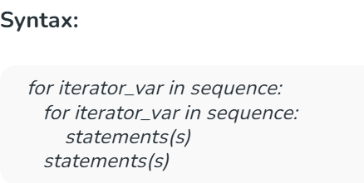
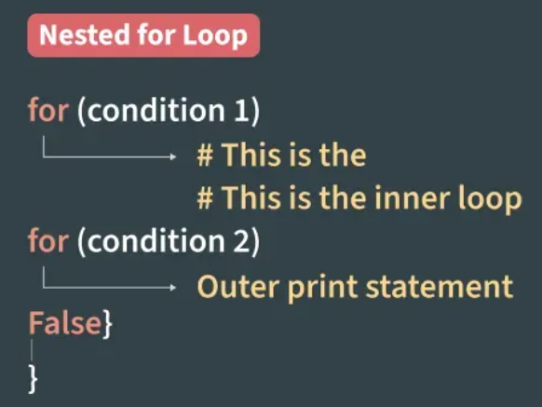
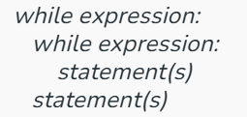
Nested Loops in Python

Slide 59
Loop Control Statements Continue and Break Statement
for letter in 'geeksforgeeks':
if letter == 'e' or letter == 's':
continue
print('Current Letter :', letter)
for letter in 'geeksforgeeks':
if letter == 'e' or letter == 's':
break
print('Current Letter :', letter)

Slide 60
Pass Statement
We use pass statement in Python to write empty loops. Pass is also used for empty control statements, functions and classes.
for letter in 'geeksforgeeks':
pass
print('Last Letter :', letter)

Slide 61

THANK YOU
Dr. Rakhee Chhibber
Rakhee.chhibber@hcltech.com

